Slide 1

Password Strength
Game
Foo Fang Woei

Slide 2

Project Vision & Background
Project Vision & Background
Educate users about strong password practices.
Provide an interactive learning game.
Three levels of difficulty to teach password creation.
Encourage awareness of cybersecurity through practice.

Slide 3
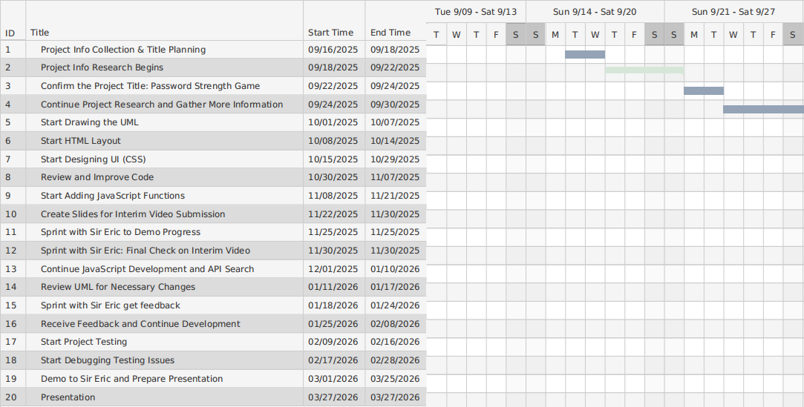
Project Plan

Slide 4
Sprint Meeting
Sprint One (25/11/2025) | Sprint Two(30/11/2025)
Update Slide Layout and Content | Review Presentation Speech
Update UML Diagram Information | Review My Recording
Check Code Details | Presentation Skills Training

Slide 5
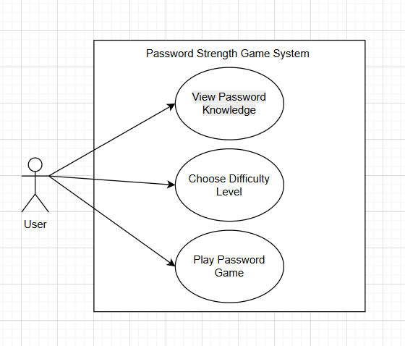
UML Models
Shows: View Knowledge, Choose Level, Play Game.
Levels Easy, Medium, Hard extend main game use case.

Slide 6

Challenges Faced & Problem
Setting clear password strength levels
API Integration Problems
API for password strength might fail, respond slowly, or have CORS issues
I must decide what rules make a password “Easy”, “Medium”, or “Hard”.
Choosing between API or built-in code
UML Mismatch
My code structure might differ from the UML design.
I need to decide whether to use a password-strength API or write our own checking rules in the code.

Slide 7
Prototype

Slide 8
THANKS

